Slide 1

Lecture : 7 (a) Tobacco and Substance Abuse
Dr. Afrin Ahmed Clara
Senior Lecturer
Department of Public Health

Slide 2
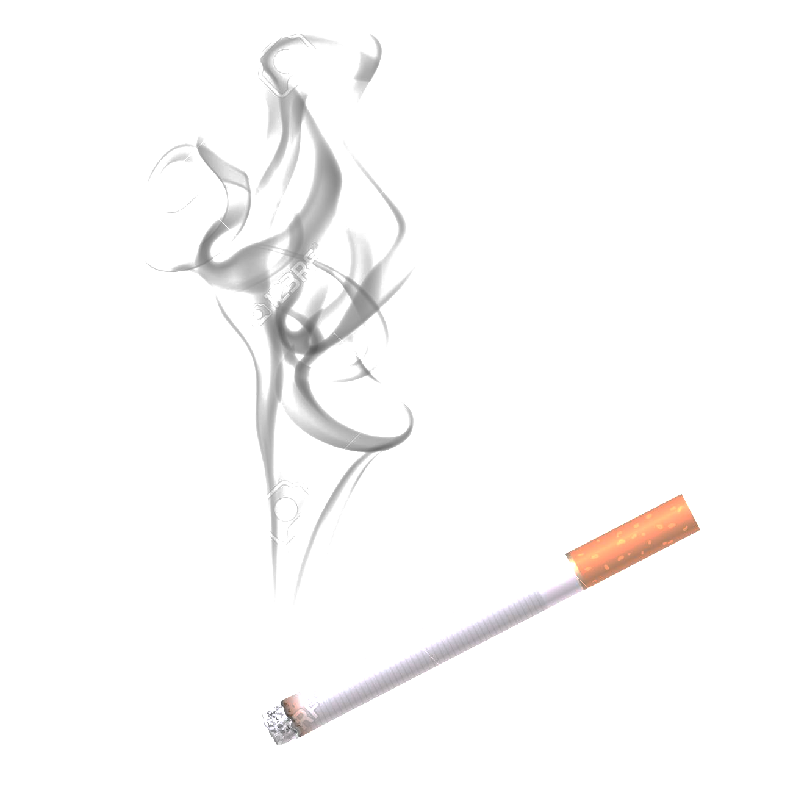
Tobacco use
Tobacco use may be defined as any habitual use of the tobacco plant leaf and its products.
The predominant use of tobacco is by smoke inhalation of cigarettes, pipes, and cigars.
Smokeless tobacco refers to a variety of tobacco products that are either sniffed, sucked, or chewed.

Slide 3
Statistics…
Tobacco kills up to half of its users.
Tobacco kills more than 8 million people each year. More than 7 million of those deaths are the result of direct tobacco use while around 1.2 million are the result of non-smokers being exposed to second-hand smoke.
Over 80% of the world's 1.3 billion tobacco users live in low- and middle-income countries.

Slide 4
Tobacco and diseases…
Smoking causes cancer, heart disease, stroke, lung diseases, and chronic obstructive pulmonary disease (COPD), which includes emphysema and chronic bronchitis.
Smoking also increases risk for tuberculosis, certain eye diseases, and problems of the immune system, including rheumatoid arthritis.
Smoking is a known cause of erectile dysfunction in males
Source: https://www.cdc.gov/tobacco/data_statistics/fact_sheets/fast_facts/index.htm#:~:text=Cigarette%20smoking%20is%20responsible%20for,or%201%2C300%20deaths%20every%20day.&text=On%20average%2C%20smokers%20die%2010%20years%20earlier%20than%20nonsmokers.

Slide 5
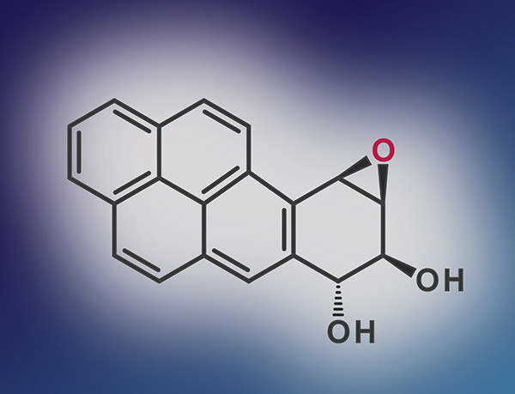
There are more than 7000 chemicals in cigarette and 70 of them are directly linked to cancer
The most well-studied of these is benzo[a] pyrene (BP). BP is one of several ring-shaped chemicals called polycyclic aromatic hydrocarbons that are produced when organic matter, such as a tobacco leaf, is burned. When it enters the body, BP becomes a powerful DNA disruptor, producing mutations that can lead to cancer.

Slide 6

Like most foreign chemicals taken into the body, BP is processed by enzymes to make it water-soluble. This change allows the kidneys to excrete the foreign chemical in urine. These water-soluble forms of BP, called epoxides, are especially good at binding to DNA. They form bulky attachments, or adducts, that bend DNA out of shape

Slide 7

By studying the DNA-carcinogen adducts at the atomic scale, scientists have learned that they preferentially form at guanine bases in DNA. Normally, a guanine base pairs with a cytosine base in the DNA helix. But when DNA with an adduct is replicated, the enzymes that do the copying tend to put an adenine base opposite this guanine, rather than the usual cytosine. This leads to what’s called a G-to-T transversion

Slide 8


Slide 9
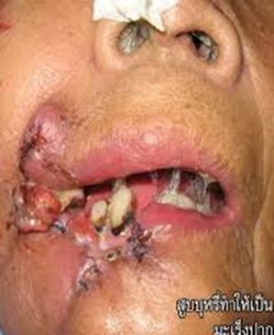
Smoking tobacco
Smokeless tobacco
Leucoplakia
loss of muscle bulk, strength, and endurance
Tobacco amblyopia, a gradual loss of visual acuity of bright light
Pancreatic cancer
Receding gums (gums slowly shrink from around the teeth)
Tooth loss
Stained and discolored teeth
Babies born to women who smoke during pregnancy have lower birth weight than babies from nonsmoking women of the same social class.
Peptic ulcer disease
Duodenal ulcer
Reduced ulcer healing
Recurrent ulceration leucoplakic

Slide 10
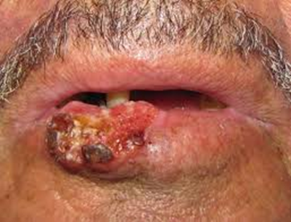
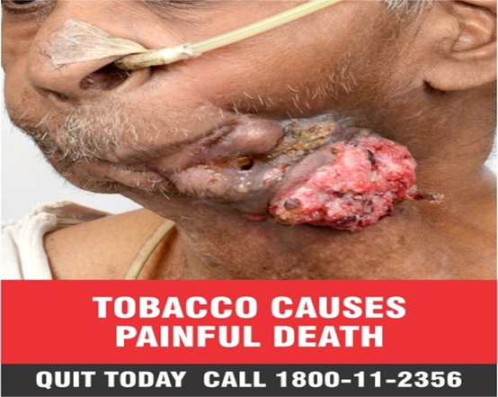
Do you want to go through something like this ……

Slide 11
Tobacco: E-cigarettes
There are many different types of e-cigarettes in use, also known as Electronic Nicotine Delivery Systems (ENDS), with varying amounts of nicotine and harmful emissions. ENDS emissions typically contain nicotine and other toxic substances that are harmful to both users and those exposed to the vapours secondhand

Slide 12
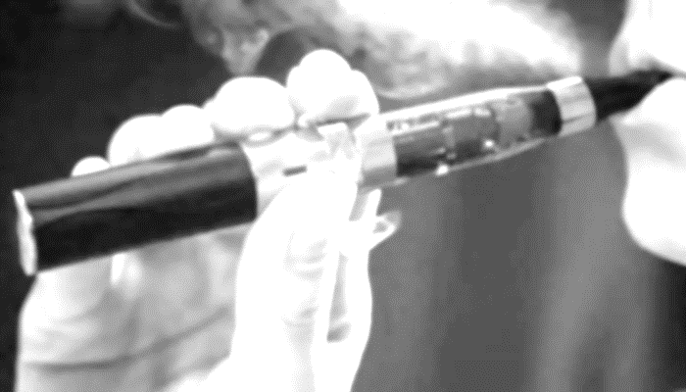
They are particularly risky when used by children and adolescents. Nicotine is highly addictive and young people’s brains develop up to their mid-twenties. Exposure to nicotine of children and adolescents can have long-lasting, damaging effects on brain development and there is risk of nicotine addiction.
Furthermore, there is a growing body of evidence in some settings that never-smoker minors who use ENDS at least double their chance of starting to smoke conventional tobacco cigarettes later in life.

Slide 13
Are ENDS addictive ?
ENDS contain nicotine, which is highly addictive, and ENDS use involves the inhalation of a nicotine-infused aerosol
https://www.hopkinsmedicine.org/health/wellness-and-prevention/5-truths-you-need-to-know-about-vaping
https://www.cdc.gov/tobacco/basic_information/e-cigarettes/severe-lung-disease.html
https://www.nm.org/healthbeat/healthy-tips/emotional-health/vaping-4-risks-for-kids

Slide 14
What are the policy option to regulate ENDS
ENDS are currently banned in over 30 countries worldwide
Where they are not banned, WHO recommends that ENDS be regulated.
Regulatory objectives include:
Preventing initiation of ENDS use by non-smokers and children, such as by preventing or restricting advertising, promotion and sponsorship, and restricting flavours that appeal to children
Minimizing as far as possible potential health and/or risks to ENDS users, such as by regulating product characteristics

Slide 15
What are the policy option to regulate ENDS
Protecting non-users from exposure to their emissions, such as by prohibiting ENDS use in indoor spaces where smoking is not permitted
Preventing unproven health claims
Protecting public health policies from commercial and other vested interests

Slide 16

Wow I am so smart …I use vape

Slide 17



Slide 18
Three ways tobacco impacts your sex life
1. Erectile dysfunction
2. Decreased libido
3. Infertility

Slide 19
Erectile dysfunction
Smoking causes damages blood circulation in penile artery
An erection is only possible when blood vessels in the penis enlarge and fill with blood. Smoking disrupts blood vessels in that area of the body, meaning the action can’t always happen.
In fact, smoking can cause erectile dysfunction in men as young as 20

Slide 20
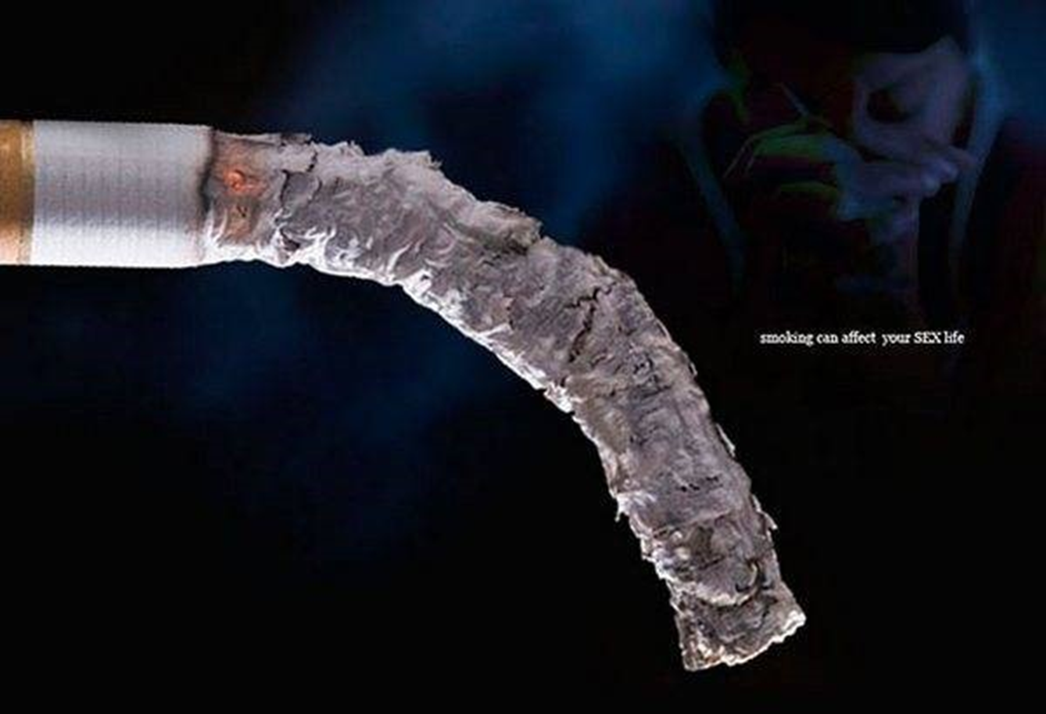
Do you want this ?

Slide 21

Why didn’t listen to Clara mam…..

Slide 22
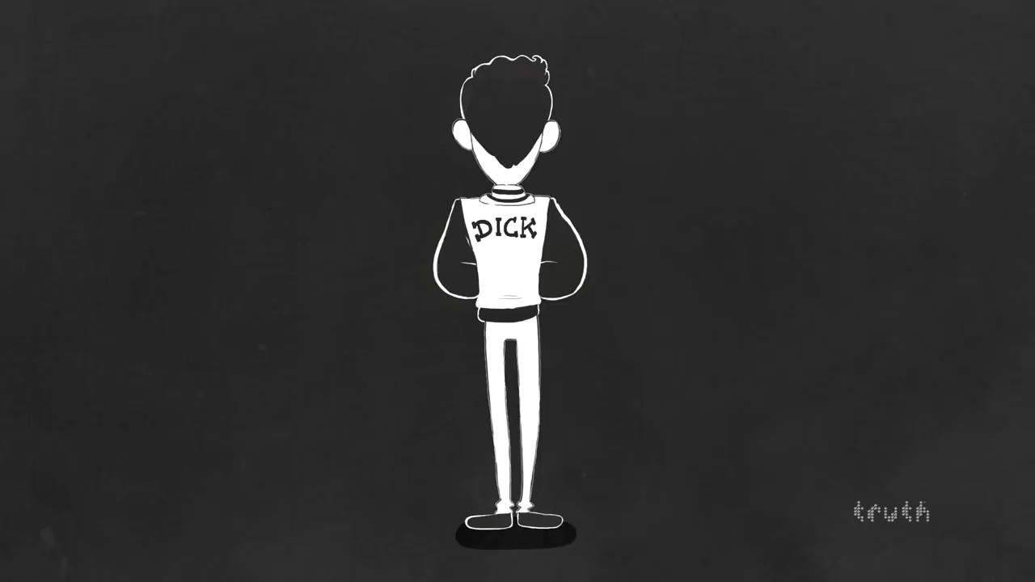
Scientific facts..not fiction

Slide 23
Decreased libido
Nicotine lower sex drive in men

Slide 24

Noooooo…….

Slide 25
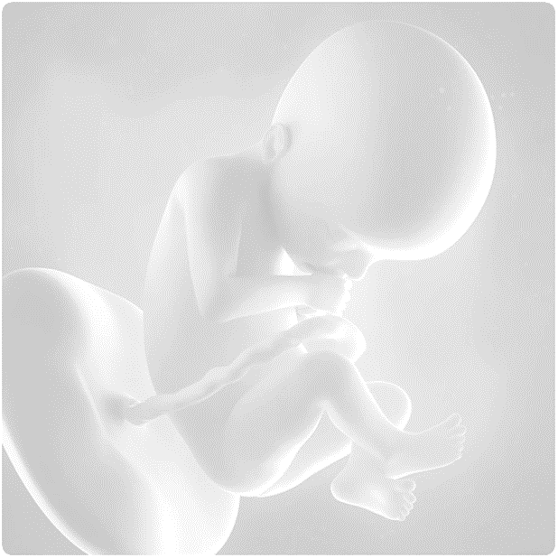
Infertility
The American Society for Reproductive Medicine warns that tobacco use can negatively affect fertility in both men and women. According to the organization, male and female smokers have about double the rate of infertility found in nonsmokers

Slide 26

Infertility
Smoking is linked to fertility challenges in several ways. Smoking damages the DNA in eggs and sperm, which can cause problems with fertility. In addition, women who smoke can also have a shorter window for getting pregnant because the chemicals in tobacco products, including nicotine, cyanide and carbon monoxide, accelerate the loss of eggs and cause smokers to experience menopause earlier than nonsmokers. The aforementioned erectile dysfunction can also contribute to failure to conceive

Slide 27
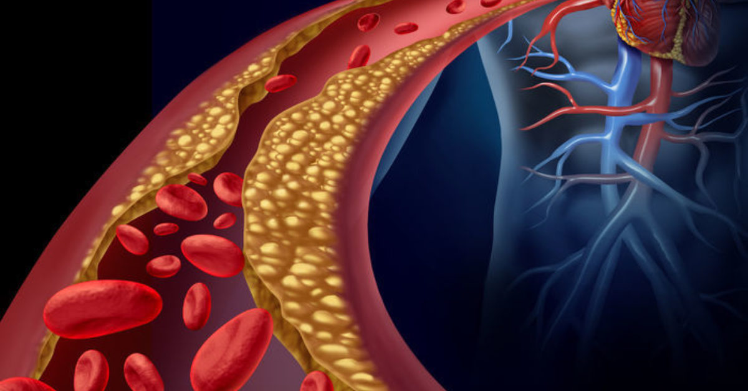
In addition to permanently damaging your heart and blood vessels, cigarette smoke can also cause CVD by changing your blood chemistry and causing plaque—a waxy substance comprised of cholesterol, scar tissue, calcium, fat, and other material to build up in the arteries, the major blood vessels that carry blood from your heart to your body. This plaque buildup can lead to a disease called atherosclerosis.

Slide 28
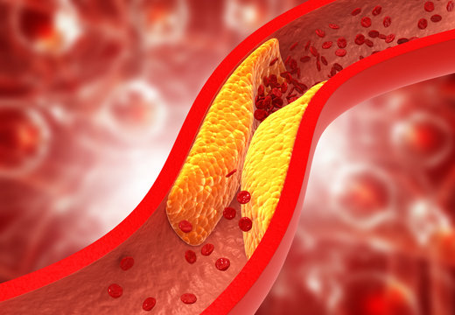
When the chemicals in cigarette smoke cause atherosclerosis and thickened blood in the arteries, it becomes more difficult for blood cells to move through arteries and other blood vessels to get to vital organs like the heart and brain. This can create blood clots and ultimately lead to a heart attack or stroke, even death.

Slide 29
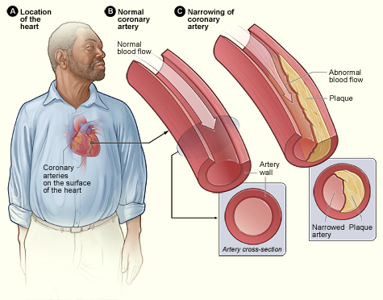

Slide 30
Results of Smoking
Bad breath and yellowing of the teeth
Cold hands and feet
Frequent or recurrent lung infections and other diseases, such as influenza, common colds, bronchitis, and pneumonia
Hypertension (high blood pressure) and rapid heart rate
Loss of taste and smell

Slide 31
Results of Smoking
Low oxygen levels in the blood
Low tolerance for exercise and fatigue
Nicotine-stained fingers and teeth
Premature aging and wrinkling of the skin
Shortness of breath and difficulty breathing

Slide 32

Although quitting smoking is difficult, it is achievable, and medicinal cessation therapies like nicotine replacement therapy (NRT) may be able to help you on your quit journey. Many addicted smokers find that FDA-approved NRT helps them get through the hardest parts of quitting by lessening cravings and symptoms of withdrawal. NRTs are proven safe and effective to help you quit smoking by delivering measured amounts of nicotine without the toxic chemicals found in cigarette smoke

Slide 33
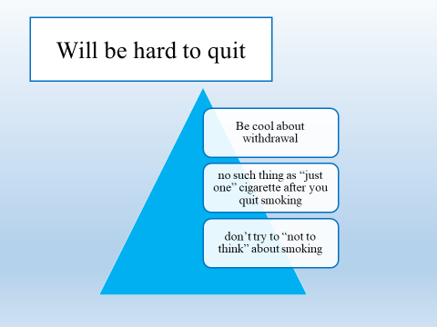

Slide 34
MPOWER Package to Reverse the Tobacco Epidemic
Monitor tobacco use and prevention policies
Protect people from tobacco smoke
Offer help to quit tobacco use
Warn about the dangers of tobacco
Enforce bans on tobacco advertising, promotion, and sponsorship
Raise taxes on tobacco

Slide 35

Even after this lecture you smoke … you are…..

Slide 36
Smart people takes his/ her own decision and stupid goes with trend
Thank you

